Slide 1

Session 17
Steps 5.1 & 5.2
Monitor, Evaluate and Adapt
Essential EAFm training
Date |Place

Slide 2
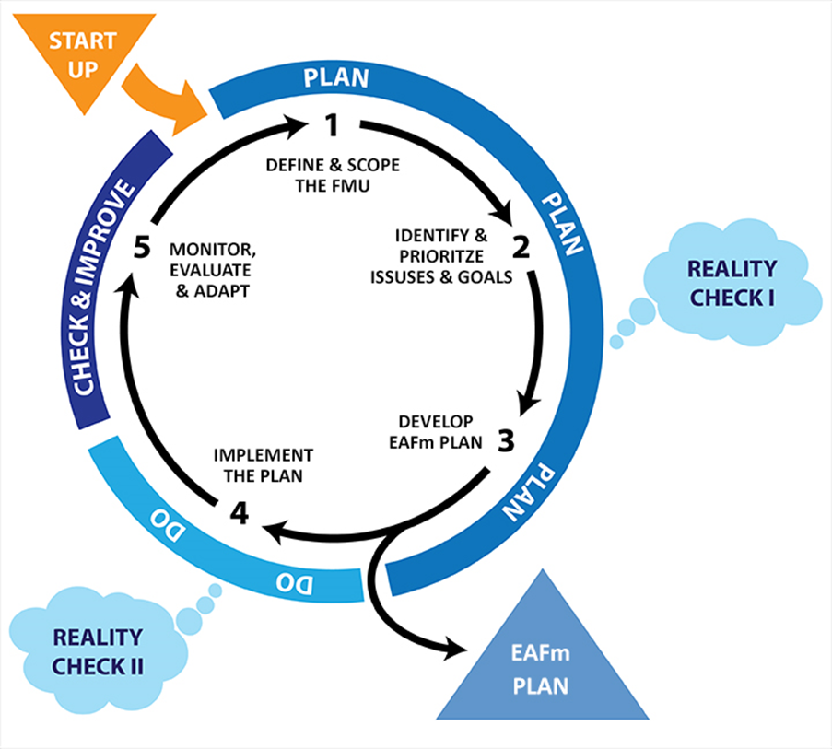
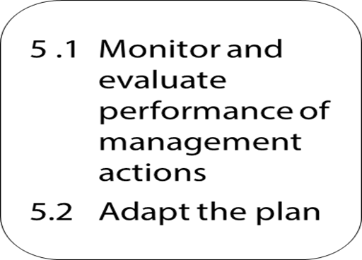


Slide 3
Session Objectives
After this session you will be able to:
Monitor how well management actions are meeting goals and objectives
Plan what has to be monitored, why,
when, how and by whom
Evaluate monitoring information and report on performance
Review and adapt the plan
Notes:
Start with a 15 minutes bus stop exercise with 3 flipcharts with 3 headings (1.why do we monitor; 2. why do we evaluate; 3. why and how do we adapt?). See session plan for how to do this activity as a ‘wake up’ when coming back from afternoon break. As you run through the slides refer to (and cross-check) participant outputs listed on 3 flip charts.

Slide 4
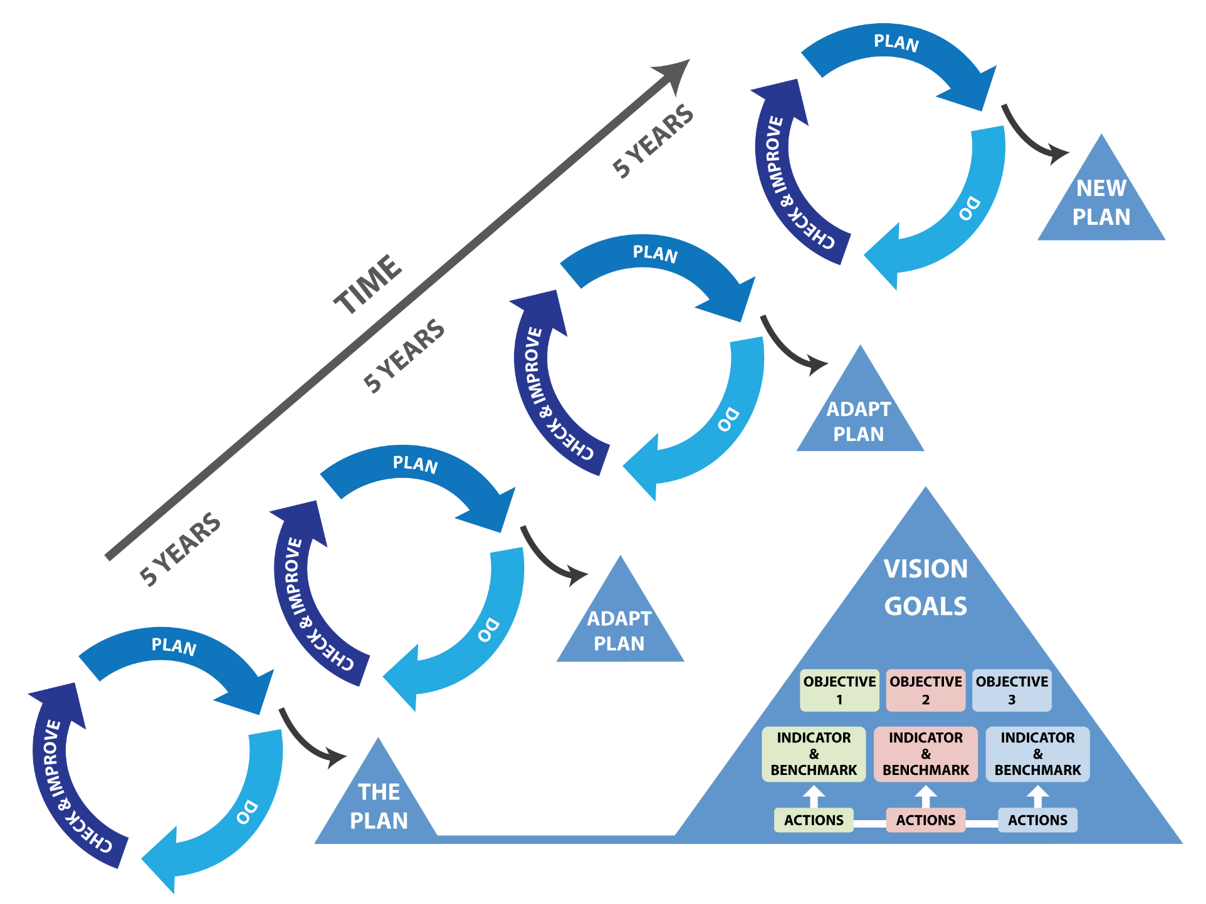
Notes:
This step links one EAFm cycle to the next. Based on the results of the M&E, the plan adapts to take into account how well the plan is tracking. So each cycle spins into the next cycle. STRESS that the plan is usually in place for at least 10 years and is a living document and can be modified and improved as we learn by doing (adaptive management).

Slide 5
Step 5 is a critical step in the management cycle
Regular monitoring and reviews of management actions are required to assess progress towards achieving objectives
Monitoring and evaluation (M&E) provides the critical information for adaptive management
NOTE: “MONITORING” IN MCS is only the monitoring of compliance with regulations, but monitoring for evaluation includes other data as there are multiple indicators, not just compliance.
Notes:
Monitoring here needs to be differentiated from fisheries jargon MCS (monitoring, control, compliance). The monitoring of MCS to a limited form of monitoring for the purpose of enforcement and compliance of rules and regulations (covered under management actions in step 3.3 Planning).

Slide 6
The Sub-Steps
5.1 Monitoring & Evaluation (M&E)
Monitor: Collect data (focus on indicators)
Evaluate: Collate results of monitoring and evaluate management performance against targets/limits (and baseline) and report
5.2 Review and adapt the EAFm plan
Review: Regular reviews of the plan
Adapt: Adapt the plan as required
Notes:
The first sub-step is 5.1 M&E. Monitoring refers to the collection of data and because we have set up indicators that link to the plan’s objectives, the focus should be on these. At regular intervals, evaluate how well you are meeting the objectives by comparing the indicator against the target and original baseline. In 5.2 we do regular reviews against the M&E reports and adapt the plan as required.

Slide 7
Monitor
Collect data for each indicator
  Avoid unfocussed data collection but do not ignore relevant information (e.g. fishermen observations, environmental change)
Monitoring continues throughout the life of the plan
Frequency of monitoring depends on the indicator
  Some indicators will require monthly, some seasonal and some annual sampling
Notes:
Check we all agree definition of monitoring: to assess progress so as to inform day to day management and implementation.
Monitoring is the collecting of data for each indicator. Monitoring is an ongoing activity and the frequency of monitoring depends on the indicator.

Slide 8
Participatory M&E
Involve the stakeholders in:
  collecting data
  deciding on the methods to use
Indicators monitored and evaluated locally have more relevance
Notes:
Link to increased participation as EAFm Principle # 3. Explain how greater involvement of stakeholders in monitoring/ evaluating interventions (Step 5.1) can lead to greater ownership= motivation/ sustainability. Stakeholders can decide their own indicators (measures of ‘well being’ and ‘improved livelihoods’ are culturally and socially specific, they encompass more than purely economic unit of income).
Challenge: who has selected indicators you are currently using? Could other stakeholders have been involved? What can you change as part of EAFm cycle- i.e. be more inclusive?
Challenges: what do we mean by well-being?

Slide 9
Evaluate Management Performance
Assess each indicator against its target/limits/baseline to measure the effectiveness of each management action.
Example:
Objective: | Increase area of freshwater fish refuge
Indicator: | Hectare of protected habitat
Baseline | 100 ha in 2010
Target | Increase 50% above baseline by 2020 (150 ha)
Progress 2014 | 50 ha (50% decrease!) | 125 ha (25% increase)
Notes:
The targets/limits and baseline developed earlier provide a standard against which we compare.
At the simplest level, because specific objectives and indicators have been chosen to cover the important ecological, social and economic issues, assessing each indicator against its targets/limits provide a snapshot of how well management is performing.

Slide 10
Evaluate Performance contd.
Evaluate all indicators
Collate, analyze and describe the overall performance of management actions
Assess other sources of information that verify (confirm or refute) the indicator evaluation
e.g. cross-check with stakeholder observations
Notes:
Do this for all indicators and analyse the overall performance of management actions. Cross-validate what the indicators are telling you with other evidence.
See Participant Handbook Module 17. Refer participants to their Workbooks for the performance review template.

Slide 11
Communicating and Reporting
The evaluation needs to be communicated
Different users will require different reporting styles
  Brief and hard-hitting for policy makers
  Simple and easy to understand for community stakeholders
Notes:
Get participants to discuss in pairs/ at their tables: who are the different users of the M&E information, what types of info they each need, and how will the access it?.
Refer to implementation work plan developed in Step 4.1. This must outline responsibilities and timeframe for M&E. The Communication strategy also developed in Step 4.1 outlines how to communicate the EAFM plan, which includes feedback and communicating results to stakeholders. So these 2 documents need to be aligned.
See module 17 communicating and reporting for examples of: which stakeholders need what type of info and how frequently.

Slide 12
Example of a simple reporting system: Traffic Lights
Red
performance is well below target, and close to limit
Orange
performance is close to target
Green
performance is at or above target
Notes:
The traffic light is an effective communication tool for reporting. Explain traffic light system: this is basically a dashboard, with different variables; there are various software packages; allows manager/ team to see immediately if you are on track or not.
Ask if any participants use/ are familiar with such a system?.
Advantages: simple and accessible to all
Disadvantages: coarse and the detail is lost.
Refer to Participant Handbook Module 17, Figure 17.2.

Slide 13
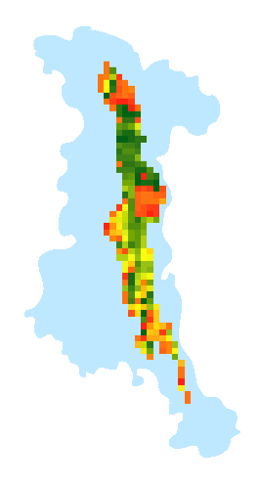
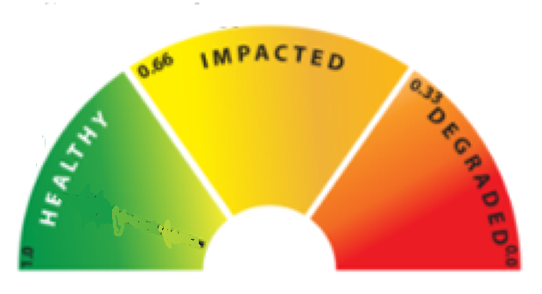
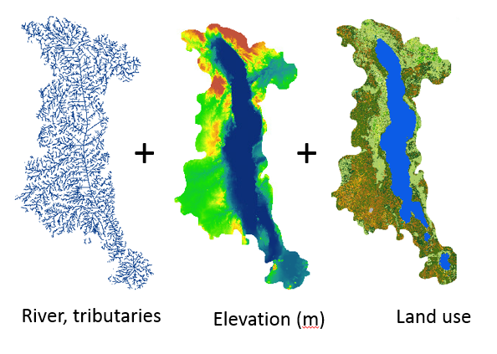
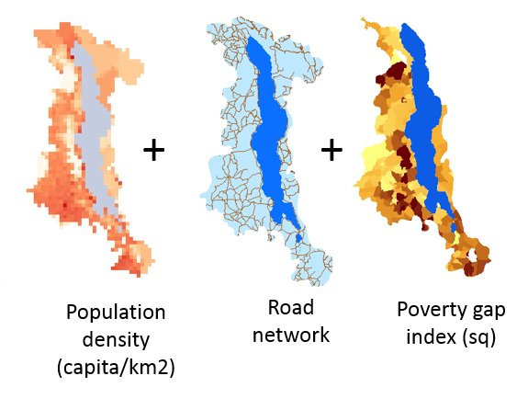
Using colours to map status
Nutrient runoff
Fishing pressure
Notes:
Refer to Participant Handbook Module 17, Figure 17.3.
This shows an Instrument panel approach, which can show whether ecosystems are healthy (green); impacted (amber) or degraded (red).

Slide 14
5.2 Review and Adapt
The evaluation report provides the basis for the participatory review of the plan
Reviews
  Short-term (annual evaluation)
  Long-term (3-5 years evaluation)
Notes:
Two types of reviews are useful : short-term reviews (every year) and longer-term reviews (every 5 years).

Slide 15
Short-term Reviews
If the plan is not working, establish why
Adapt the plan:
  Management actions
  Compliance
  Governance arrangements
Notes:
This is basically what you need for short term review. Changes to the plan based on annual reviews should focus on the management actions and their compliance as well as governance arrangements.

Slide 16
Longer-term Reviews
Carry out a comprehensive review every 3-5 years.
It may be necessary to:
Reconsider goals, objectives, indicators, etc.
May need to rethink the whole plan and management system
Often carried out by independent auditor
If the plan is working, celebrate!!
Notes:
Refer participants to last 2 pages of Participant workbook for the EAFm progression matrix. Trainer needs to explain that participants can use this matrix of helpful checks and questions to support and track their efforts in moving towards EAFm (by ticking of each question once that element is in place).
So it is a matrix for ‘work in progress’ and can be referred to continuously.

Slide 17
Short-term reviews
Evaluate and adapt
  Management actions
  Compliance arrangements
  Governance arrangements
Long-term reviews
Evaluate and adapt
  Reconsider goals, issues and linked objectives, actions and indicators
1 YEAR
Monitoring
3-5 YEAR
Notes:
This visual summarizes the process. Monitoring is on-going and once a year the review looks at whether the management action is working. On a longer time scale, the review may need to make larger adaptations.
Refer to Participant Handbook Module 17, Figure 17.4.

Slide 18
Key Messages
In Step 5:
Monitor, evaluate and adapt completes the EAFm cycle, ready to enter the next cycle
Yearly review: are you meeting objectives?
  if not, adapt the management actions and compliance arrangements, where necessary
5-yearly review: are you meeting objectives and goals?
  if not, may be necessary to also revisit issues and goals as well
Notes:
Self explanatory

Slide 19
Home Work: Preparing presentations for Day 5
EAFm plans
No PowerPoints
Use flipcharts, cards …be creative!
Trainers need to see learning and applying EAFm concepts and tools
Everyone participates
Supportive environment – constructive feedback
Notes:
Explain how day 5 will work: after reviews of day 4 and quiz, groups will get some preparation time (maximum 1 hour). Early break and then presentations until lunchtime. After lunch will focus on course review, evaluation and action planning.
NB: Ideally, try presentations on flipchart ONLY (to be agreed by trainers with participants). So participants need to work on their own notes in Workbook/electronically, but main medium on day 5 will not be PowerPoint (this is to avoid long presentations where participants just copy and paste from previous presentations; also PowerPoint does not show learning as it’s not so interactive).
We need to see their learning. For participants this is a chance to elaborate on their EAFm plans and ‘test’ them out in supportive environment.
Trainers : see Session Plan for day 5 (session 18+19) for more details. Decide order of group presentations (trainer-only discussion). Tip: have a strong group to start and finish, and have weaker groups in the middle.
Optional: trainers to prepare one A4 handout presentation programme with FMU group titles, logos and sequence (this can be done by 1 trainer during the 1st hour of prep time on day 5, you will not be able to plan sequence before then as you need to have in idea of what each group is presenting, and their level of quality).

Slide 20
EAFm QUIZ!
☺
Notes:
This is NOT a test. Purpose is to assess where participants are and to see if the training course has managed to convey all the key EAFm elements in an accessible way. Distribute quiz. Participants complete it in silence, individually (15-20 minutes).

